Slide 1
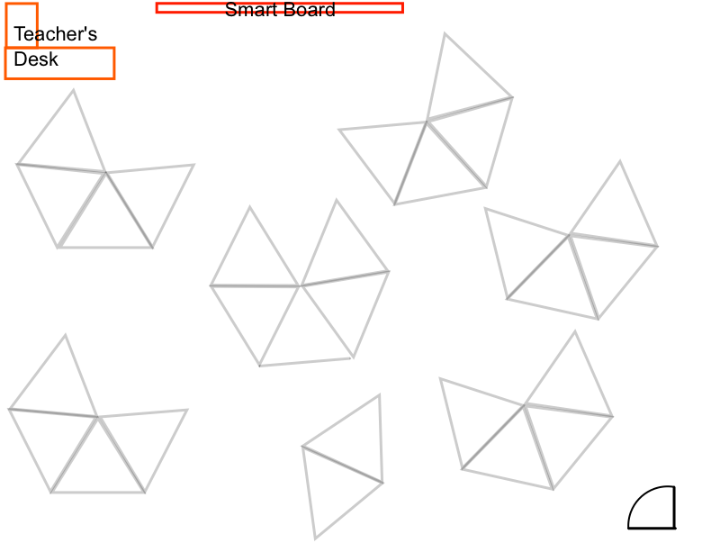
Jean
Melanie
Christopher
Michael
Edgar
Luis
Nichole
Brent
Ben
Diego
Lucas
Amal
Josh
Leslye
Emiljano
Mariam
Oasis
Ruben
Frank
Julian
Eliut
Avery
Eliezer
Kalani
Eric

Slide 2
laptop assignments
1 Melanie Alvarez
2 Mariam A. Abosheta
3 Christopher Baez
4 Michael A. Becerra
5 Emiljano Bodaj
6 Nichole Calle
7 Diego G. Del Real
8 Brent A. Figuera
9 Leslye E. Galindo
10 Oasis M. Hawk
11 Frank B. Johnson
12 Edgar Martinez Romero
13 Avery L. Mcdonald
14 Julian Montalvo
15 Eliut J. Ortiz
16 Joshua C. Pena
17 Eliezer I. Polanco
18 Kalani Quinones
19 Eric D. Razor Jr
21 Luis Reyes
22 Lucas K. Schlenk
23 Benjamin Schmitt
24 Amal Tashmatov
25 Jean P. Tatis Bueno
26 Ruben D. Tineo

Slide 3
take a laptop,
go straight to your seat, and
log into WeScheme
www.wescheme.org
Log in with your @afsenyc.org email address
Start a new program
Save your program as
01 - Formal language

Slide 4
Formal Language
What do we need to know to write expressions in WeScheme?

Slide 5

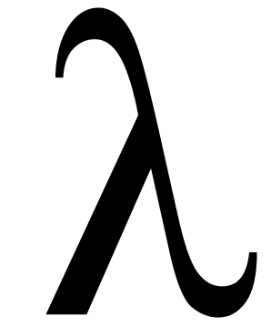


many names
Racket - the actual language we will be using
Scheme - the parent of Racket
WeScheme - a cloud-based programming environment for Racket
Bootstrap - a curriculum for teaching mathematics with Racket

Slide 6
formal vs. informal language

Slide 7
expression
anything that can be evaluated

Slide 8
numbers
everything you already think of

Slide 9
functions
all operations are functions, so + is a function.
5+4
+ takes 5, 4 and adds them

Slide 10
circles of evaluation
Math
Circle of Evaluation
Racket Code

